Slide 1

 | S.S.V.P.S’s B. S. Deore Polytechnic, Dhule Department of Computer Engineering Academic Year : 2025-2026
SEMINAR AND PROJECT INITIATION COURSE
Sem : CO 5 K |  | SPI – 315003 | Date : 11 Oct’ 2025
Topic : AI-Based UX/UI Design Generator Using NLP
Roll No. |  | Name of Student
56 |  | Jagruti Pankaj Patil
53 |  | Hemangi Dilip Patil
45 |  | Ishwari Vikas Nagare
42 |  | Sarthak Dnyaneshwar Marathe

Slide 2
Contents
Abstract
Introduction
Literature Review
Information to Seminar topic
Advantages and Disadvantages
Conclusion
Project Initiation :
  Description of problem statement.
  Scope and objectives.
  Stake holder
  Platform/ Equipment/ Resources identification.
Bibliography
References

Slide 3
Abstract
AI-Based UX/UI Design Generator Using NLP is a proposed system designed to simplify the process of user interface and user experience design. Traditional UI/UX design requires considerable time, effort, and design knowledge. The proposed system uses Natural Language Processing (NLP) to understand user requirements written in simple language and identify important interface components such as pages, buttons, forms, layouts, and content.
It aims to assist in generating an initial interface design, reduce manual effort, and improve the efficiency of the prototyping process. The system can help developers and users create initial UI designs without requiring advanced design skills. The generated designs can be reviewed and modified according to user requirements.

Slide 4
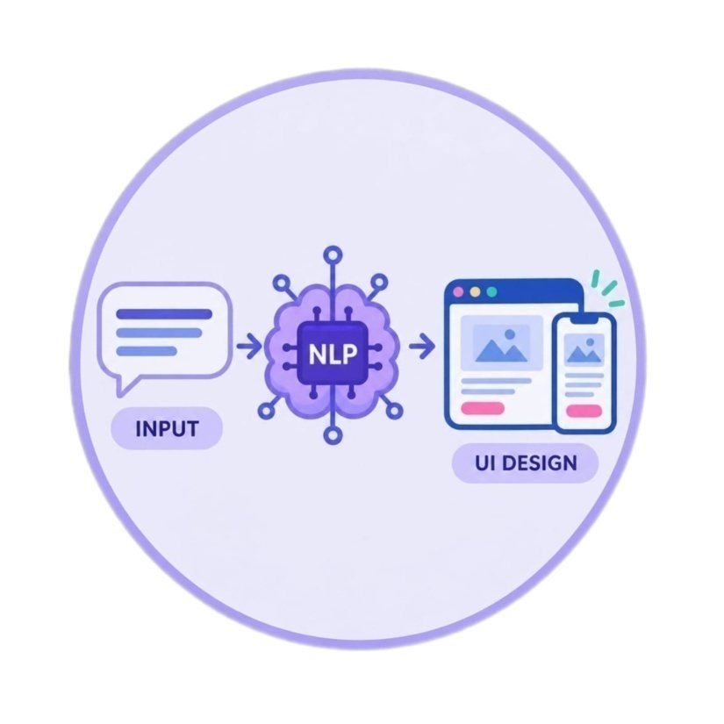
1. Introduction
UI/UX design is an important part of modern
software applications and websites.
User Interface (UI) focuses on the visual
elements, while User Experience (UX)
focuses on usability and user satisfaction.
Traditional UI/UX design requires manual effort,
time, and design knowledge.
Natural Language Processing (NLP) helps
computers understand requirements written
in human language.
Artificial Intelligence (AI) can assist in generating
layouts, buttons, forms, and other interface components.
The proposed system aims to simplify initial UI design
and reduce prototyping time.

Slide 5
2. Literature Survey
Sr. No. | Approach Type | Technologies Used | Dataset | Key Objective | Limitations
1 | NLP-based requirement extraction | NLP, GUI Retrieval, BERT-based models | GUI design repository | Retrieve suitable GUI designs based on user requirements. | Retrieved designs may require manual modifications.
2 | AI-assisted UI/UX design | Artificial Intelligence, Machine Learning | Depends on the research study | Improve design efficiency and automate repetitive tasks. | Output quality depends on the AI model.
3 | Generative UI design | Generative AI, Large Language Models | Depends on the model and evaluation method | Generate interface layouts and components from user prompts. | Generated layouts may not fully match user requirements.

Slide 6
Sr. No. | Approach Type | Technologies Used | Dataset | Key Objective | Limitations
4 | NLP-based requirement extraction | NLP, Text Processing, Tokenization | Natural-language UI requirement | Identify pages, buttons, forms and other UI components. | Ambiguous text may produce incorrect results.
5 | Text-to-interface generation | NLP, Generative AI, HTML, CSS | Text prompts and generated interfaces | Convert text descriptions into initial UI designs. | Complex prompts may generate incomplete interfaces.
6 | Data-driven GUI prototyping | GUI Retrieval, NLP, Information Retrieval | Existing GUI examples | Reuse relevant interface examples to reduce prototyping effort. | Retrieved examples may need customization.

Slide 7
Sr. No. | Approach Type | Technologies Used | Dataset | Key Objective | Limitations
7 | AI-based layout generation | Generative AI, Machine Learning | UI layouts and design examples | Generate suitable layouts based on user requirements. | Layout consistency may vary.
8 | Automated UI component generation | AI, NLP, HTML, CSS | UI component examples | Generate buttons, forms and other interface elements. | Advanced styling may require manual work.
9 | Human-AI collaborative design | AI design tools, Generative AI | Designer feedback and interface examples | Combine AI-generated designs with human creativity. | Human review remains necessary.

Slide 8
Sr. No. | Approach Type | Technologies Used | Dataset | Key Objective | Limitations
10 | AI-assisted rapid prototyping | Generative AI, UI design tools | Prototype examples | Reduce the time required to create initial prototypes. | Results may need repeated refinement.
11 | NLP-based UI customization | NLP, Machine Learning | User requirements and interface examples | Adapt interface components according to user needs. | Complex requirements may not be handled accurately.
12 | Integrated AI-based UI/UX generation | NLP, Generative AI, Web Technologies | Depends on the implemented system | Combine requirement understanding and interface generation. | Accuracy and customization depend on system capabilities.

Slide 9
3. Information to seminar topic
Technology: Artificial Intelligence (AI), Natural Language Processing (NLP), Generative AI and Web Technologies.
Main Purpose: To simplify UI/UX design by converting natural-language requirements into an initial interface design.
Key Concept: Understanding user requirements and identifying suitable UI components such as buttons, forms, pages and layouts.
Approach: The proposed system processes the user's text, extracts important requirements and assists in generating an initial interface design.
Main Benefit: Reduces manual effort, saves time and supports rapid prototyping.
Applications: Website prototyping, mobile application design, educational projects, business applications and software development.

Slide 10
4. Advantages / Disadvantages
Advantages:
Reduces the time required for initial UI/UX design.
Allows users to describe requirements in natural language.
Automates parts of the interface design process.
Supports rapid prototyping and design experimentation.
Reduces repetitive manual work.
Can store relevant project data using MongoDB, if implemented.
Disadvantages:
Output quality depends on the clarity of user input.
Complex requirements may not be interpreted correctly.
Generated designs may require manual modifications.
NLP may not extract every requirement accurately.
Advanced customization may be limited.
Human review is necessary before finalizing the design.

Slide 11
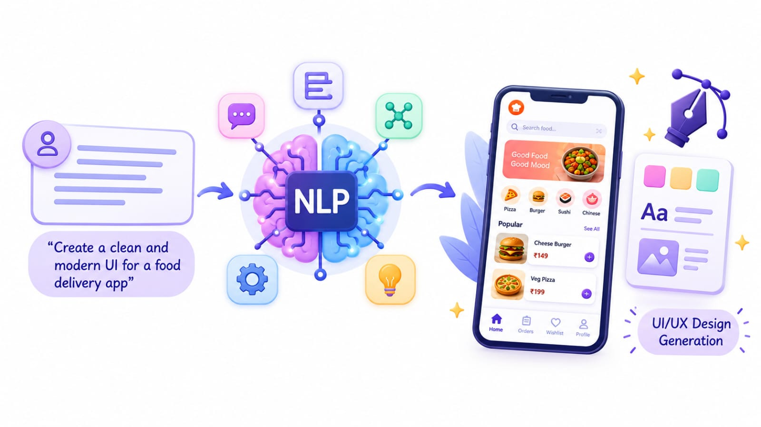
5. Conclusion
AI-Based UX/UI Design Generator Using NLP simplifies the process of interface design by converting natural-language requirements into initial UI designs. It reduces manual effort, saves time, and supports rapid prototyping. Overall, it makes UI/UX design easier and more accessible, although human review and modifications may still be required.

Slide 12
6. Project Initiation
The proposed AI-Based UX/UI Design Generator Using NLP addresses the time and effort required to create initial user interfaces. Traditional design methods require users to manually create layouts, buttons, forms and navigation elements.
The proposed system accepts requirements written in natural language and processes them using NLP techniques. It identifies important interface components and assists in preparing an initial design that can be reviewed and modified.
The project aims to simplify the prototyping process, improve productivity and make initial interface design easier for developers and users.

Slide 13
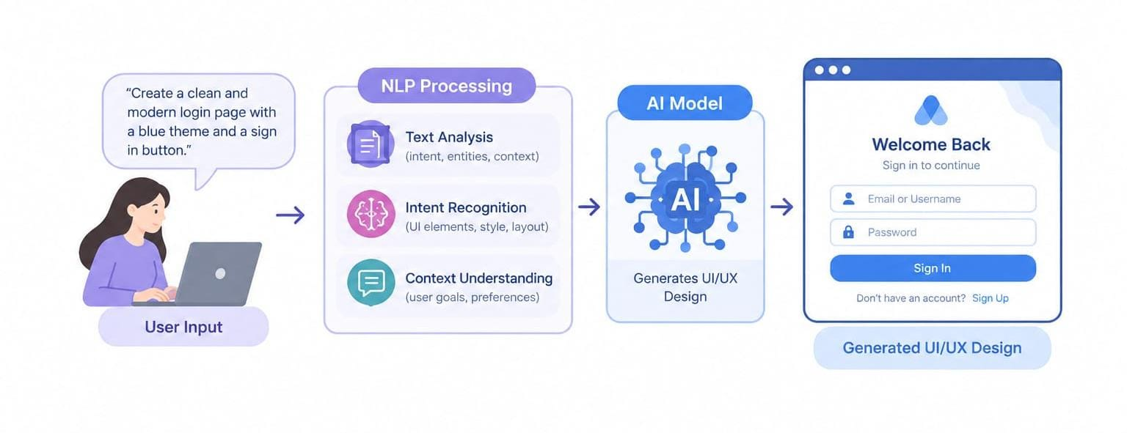
6(a) Problem Statement
Traditional UI/UX design requires considerable manual effort, time and design knowledge. Users must manually plan layouts, forms, buttons and navigation elements to create an interface.
This process can be difficult for beginners and may require repeated modifications. The proposed system aims to address this problem by processing natural-language requirements and assisting in the generation of an initial interface design.
It focuses on reducing repetitive work, simplifying prototyping and improving the efficiency of the initial design process.

Slide 14
6(b) Scope and Objective
Objectives:
Accept user requirements written in natural language.
Process text using Natural Language Processing (NLP).
Identify important UI components and design requirements.
Assist in generating an initial user interface.
Provide a simple and user-friendly design process.
Store relevant information using MongoDB, if included in the implementation.
Scope:
Initial UI/UX design generation from text requirements.
Identification of pages, buttons, forms and other components.
Creation of interface prototypes for review and modification.
Support for website and application prototyping.
Future integration with advanced Generative AI models.
Further improvements in customization and requirement understanding.

Slide 15
6(c) Stake holders
End Users:
Provide requirements in natural language and review the generated interface.
UI/UX Designers:
Use AI-generated initial designs as a starting point for prototyping.
Developers:
Review the generated interface and use it during application development.
Project Team:
Develop, test and maintain the proposed system.
Project Guide:
Provides guidance, reviews project progress and evaluates the project.

Slide 16
6(d) Platform / Equipment / Resources identification
1. Development Platform
Windows or Linux operating system.
Python development environment.
Web browser for viewing and testing interfaces.
Development tools for implementing NLP-based processing.
2. System Equipment
Computer or laptop for development and testing.
Minimum 4 GB RAM, with higher memory recommended for AI tools.
Internet connection for accessing documentation and AI services.
Keyboard and mouse for development work.
3. Supporting Resources
Python programming language.
NLP libraries and tools.
MongoDB for data storage, if implemented.
HTML and CSS for interface development.
Visual Studio Code or a similar code editor.
Research papers and technical documentation related to AI and UI/UX design.

Slide 17
Bibliography
Books
Natural Language Processing — reference material on language processing techniques.
Artificial Intelligence: A Modern Approach — Stuart Russell and Peter Norvig.
Software Engineering — Ian Sommerville.
Reference materials on user interface and user experience design.
Websites
Python Official Website – https://www.python.org
Python Documentation – https://docs.python.org/3
MongoDB Official Website – https://www.mongodb.com
Natural Language Toolkit (NLTK) – https://www.nltk.org

Slide 18
References
F. Huang, G. Li, X. Zhou, J. F. Canny, and Y. Li, “Creating User Interface Mock-ups from High-Level Text Descriptions with Deep-Learning Models,” arXiv preprint arXiv:2110.07775, 2021. [Online]. Available: https://arxiv.org/abs/2110.07775
K. Kolthoff, C. Bartelt, and S. P. Ponzetto, “Data-driven prototyping via natural-language-based GUI retrieval,” Automated Software Engineering, vol. 30, Art. no. 13, 2023. [Online]. Available: https://doi.org/10.1007/s10515-023-00377-x
L. Sun, “AI-assisted UI design: Enhancing efficiency and creativity through generative tools,” Journal of Computer Technology and Applied Mathematics, vol. 3, no. 1, 2026. [Online]. Available: https://doi.org/10.70393/6a6374616d.333638
M. Yuan et al., “Towards Human-AI Synergy in UI Design: Enhancing Multi-Agent Based UI Generation with Intent Clarification and Alignment,” arXiv preprint arXiv:2412.20071, 2024. [Online]. Available: https://arxiv.org/abs/2412.20071
X. Feng, H. Du, J. Ma, H. Wang, L. Zhou, and M. Wang, “Crafting User-Centric Prompts for UI Generations Based on Kansei Engineering and Knowledge Graph,” 2025. [Online]. Available: https://doi.org/10.1016/j.aei.2025.103217
T. Zhang, F. Peiguo, J. Liu, Y. Zhang, and X. Chen, “NLDesign: A UI Design Tool for Natural Language Interfaces,” 2024. [Online]. Available: https://doi.org/10.1145/3674399.3674455

Slide 19
References
5. Y. Cao, P. Jiang, and H. Xia, “Generative and Malleable User Interfaces with Generative and Evolving Task-Driven Data Model,” in Proc. CHI Conference on Human Factors in Computing Systems (CHI ’25), 2025. [Online]. Available: https://doi.org/10.1145/3706598.3713285
6. T. Calò, A. Sillano, and L. De Russis, “MorphGUI: Real-time GUIs customization with large language models,” International Journal of Human-Computer Studies, 2026. [Online]. Available: https://doi.org/10.1016/j.ijhcs.2025.103695
7. “DesignCoder: Hierarchy-aware and self-correcting UI code generation with large language models,” Information and Software Technology, vol. 198, Oct. 2026. [Online]. Available: https://doi.org/10.1016/j.infsof.2026.108214
8. F. Wu, C. Gao, S. Li, X.-C. Wen, and Q. Liao, “MLLM-Based UI2Code Automation Guided by UI Layout Information,” arXiv preprint arXiv:2506.10376, 2025. [Online]. Available: https://arxiv.org/abs/2506.10376
9. Z. Yang et al., “UI2Code^N: A Visual Language Model for Test-Time Scalable Interactive UI-to Code Generation,” arXiv preprint arXiv:2511.08195, 2025. [Online]. Available: https://arxiv.org/abs/2511.08195
10. Y. Xu, Y. Liu, H. Xu, and H. Tan, “AI-driven UX/UI design: Empirical research and applications in FinTech,” International Journal of Innovative Research in Computer Science and Technology, vol. 12, no. 4, pp. 99–109, Jul. 2024. [Online]. Available: https://doi.org/10.55524/ijircst.2024.12.4.16

Slide 20
Thank you

